Slide 1
Creating the Environment
Mack 2023

Slide 2
Learning Objectives
Students will be able to set up a project for a platform game.
Students will be able to create a tile map for their game.
Students will be able to add sprites to their game.

Slide 3
Project Setup
Creating a 2D game with Godot is a great way to get started with game development. In this lesson, we will go through the steps of setting up a project and adding sprites to it.

Slide 4
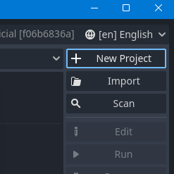
Opening the Project Manager
The first step is to open up the Godot project manager by running the .exe, we can then create a New Project.

Slide 5
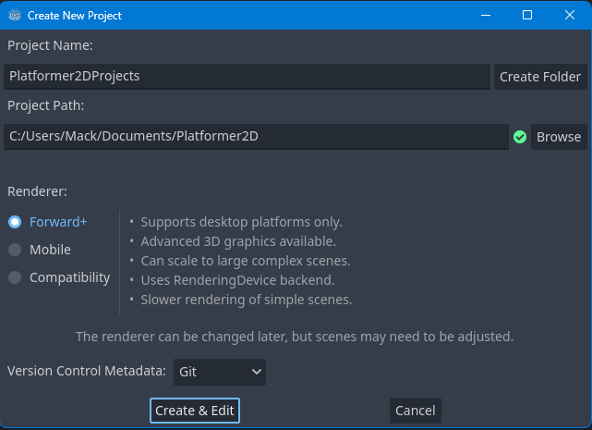
Opening the Project Manager
We can then fill out the Project Name section, we will be calling our project Platformer2DProject. Then, you can choose a Project Path to where you want to store the Godot project files. This needs to be an empty folder.
Notes:
Then press Create & Edit to open the new project.

Slide 6
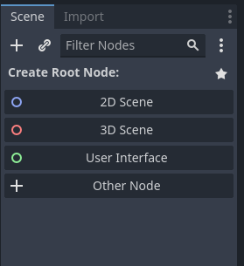
Creating the Root Node
As we will be creating a 2D game, we first need to swap to the 2D view on the top row.
We then need a root node for our scene, to do this we will select the 2D Scene option in the Scene tab.
Notes:
Then press Create & Edit to open the new project.

Slide 7
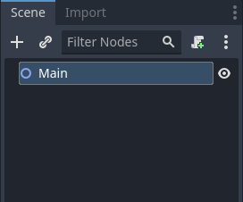
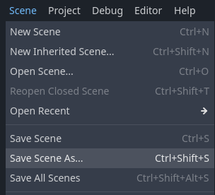
Creating the Root Node
We can then rename this to Main so that it is easily identifiable as our scene’s root node.
We will then open the Scene menu from the top row and choose Save Scene As…
We will then save it as Level1.tscn or a similar name and press the Save button.

Slide 8
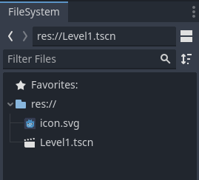
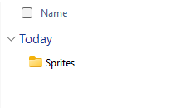
Adding Sprites
The next step is to add sprites to your project. You can use your own 2D sprites, or you can download the sprites included in the course files. If you choose to use our provided sprites, extract the contents of the zip file. With the new folder open, drag-and-drop the Sprites folder into the Godot Editor’s FileSystem tab.

Slide 9
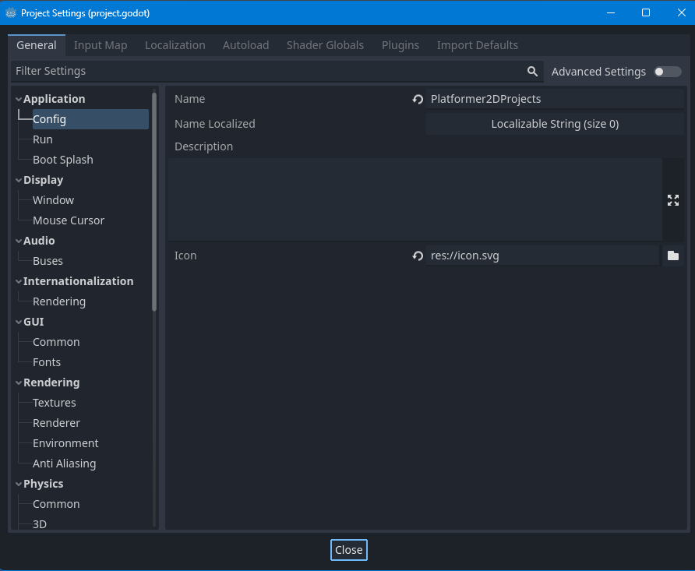
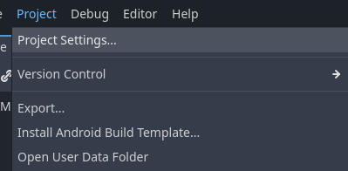
Adding Sprites
As we are using pixel art sprites the default import settings make them appear blurry, you can fix this by going to Project and selecting Project Settings.

Slide 10
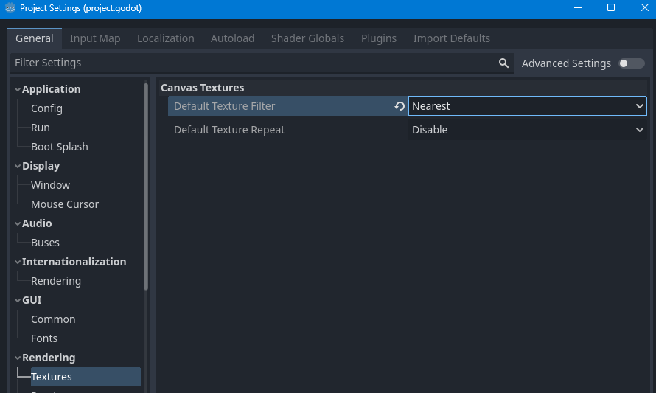
Adding Sprites
Under the Rendering section, select the Textures tab, and change the Default Texture Filter to Nearest.
Notes:
Now that you have set up your project and added sprites to it, we are ready to start creating your game. In the next lesson, we will look at setting up the game environment.

Slide 11
Creating the Environment
Creating a tile map is an important step in setting up a platform game. It allows you to create a grid that can be used to paint with sprites. In this article, we will go through the steps of creating a tile map and setting up the environment for our platform game.

Slide 12
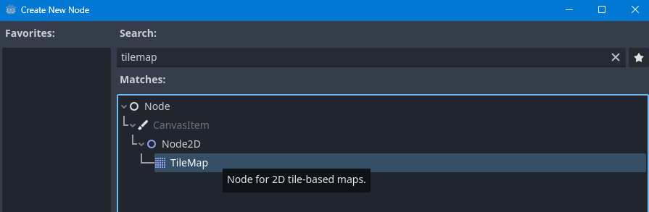
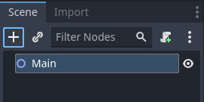
Creating the Tile Map
To begin, we need to create a TileMap node. To do this, go to the Scene tab and click on the plus sign. We then search for the TileMap node and create it.

Slide 13
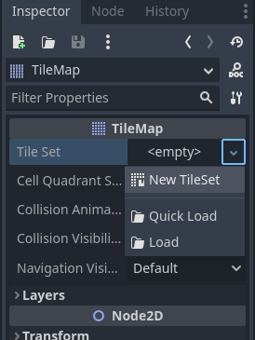
Creating the Tile Map
Once the tile map is created, go to the inspector tab and click on the tile set button to create a New TileSet.

Slide 14
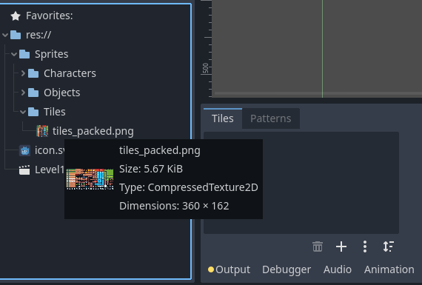
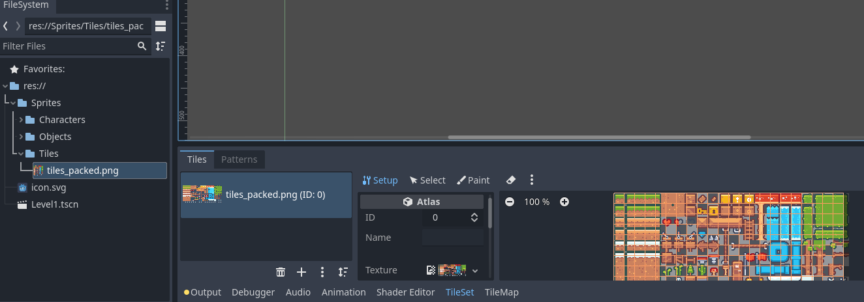
Creating the Tile Map
This will open up the tile set window along the bottom of your editor. Here, we need to tell the tile map what sprites we want to use to construct our level. To do this, drag-and-drop the tiles-packed.png file into the white box.
Notes:
If you get a popup, click yes.

Slide 15
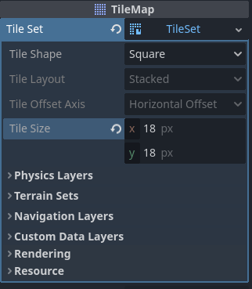
Creating the Tile Map
If the tile size appears wrong inside the Tiles editor, go to the
Inspector window and change the Tile Size to 18 by 18. This will ensure that the sprites are correctly aligned, if you are using your own textures, you may want to use different values.

Slide 16
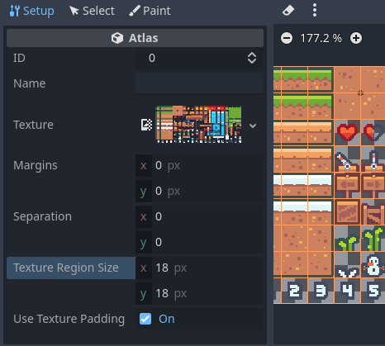
Creating the Tile Map
Then, in the Properties panel of the Tiles editor, change the Texture Resolution to be the same 18
by 18. This will make the grid match up with your tiles.

Slide 17
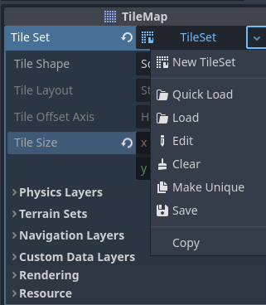
Creating the Tile Map
If you are using a custom tileset, it may have gaps in between the tiles. You can add this using the Separation and Margins options.
Now, if you want to use this tile set across multiple tile maps, in other scenes for example, then you can save it to your File System. Just click on the down arrow next to the Tile Set and select Save.
This will then create a new resource in your File System which you can drag and drop into a new tile map.

Slide 18

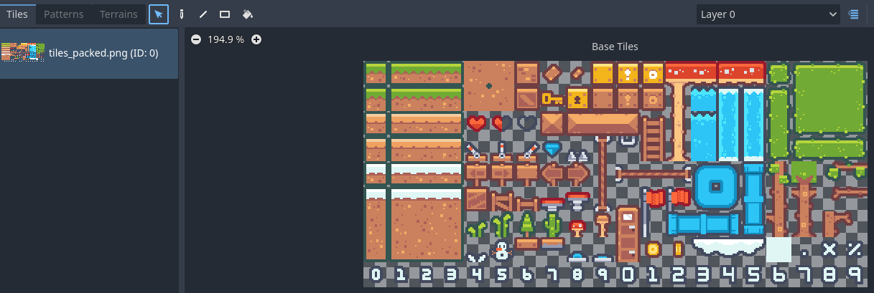
Painting the Level
Now that the tile map is set up, we can begin painting the level. To do this, open the tile map window.
Then chose the Select tool in the editor (or use the shortcut Q), as this is the tool needed to draw our tiles on the Tilemap node.

Slide 19
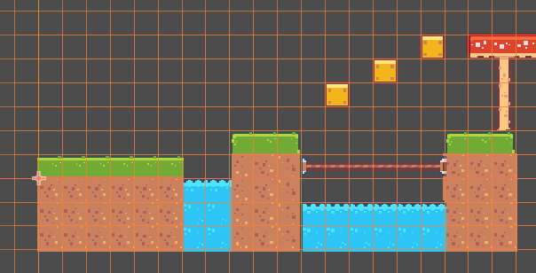
Painting the Level
Now if you Left-Click on the grid in the editor you can place tiles, or Right-Click to remove tiles. You can then select the tile you want to draw with from the Tiles panel and use them to construct the level.

